Slide 1

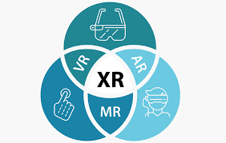
all about
Extended
reality
Presented by Sajid Islam
1

Slide 2
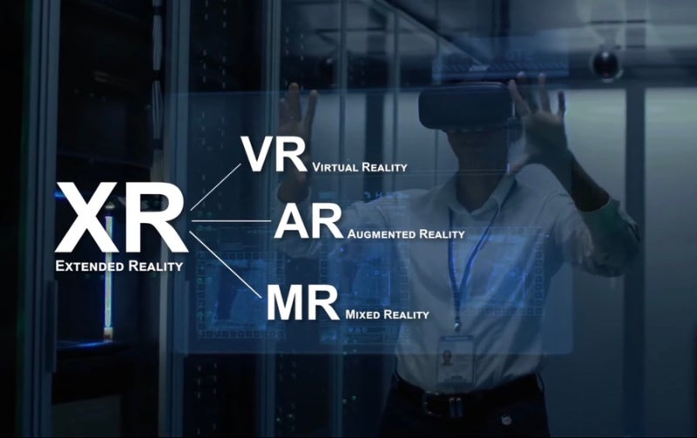
Introduction to XR
Extended Reality (XR) is an umbrella term for Virtual Reality (VR), Augmented Reality (AR), and Mixed Reality (MR).
XR blends real and virtual environments to create immersive experiences.
XR is revolutionizing industries like healthcare, education, and entertainment.

Slide 3
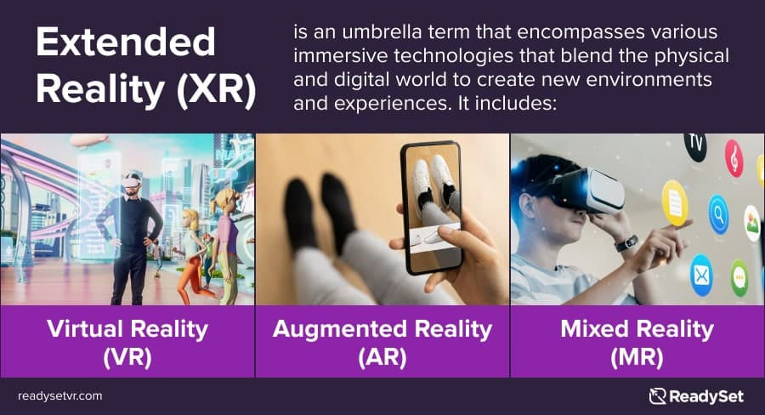
3

Slide 4

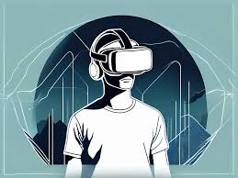
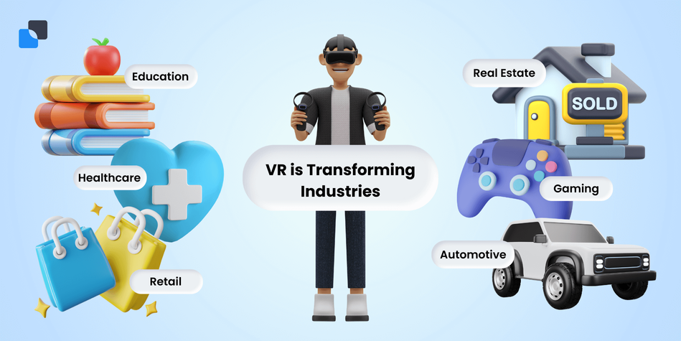
Virtual Reality (VR)
Virtual Reality (VR) fully immerses users in a computer-generated environment, isolating them from the physical world.
Key Features
360-degree views and interactive digital environments.
Uses VR headsets like Meta Quest, HTC Vive, or PlayStation VR.
Simulates sensory experiences (sight, sound, touch).
4

Slide 5
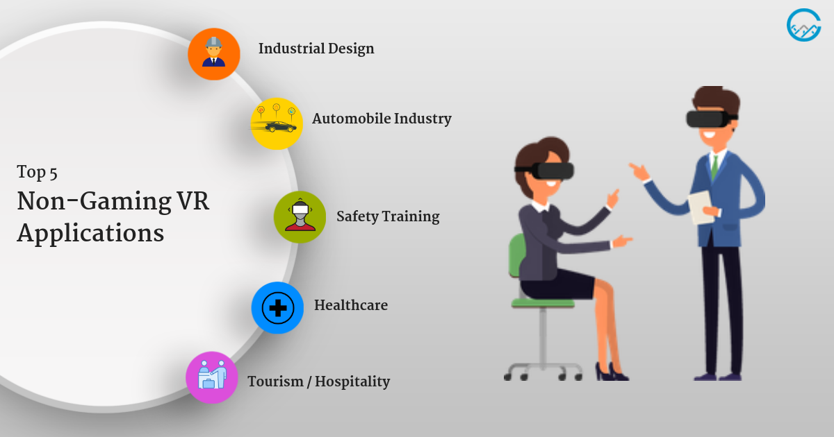
Virtual reality’s
Application
5

Slide 6
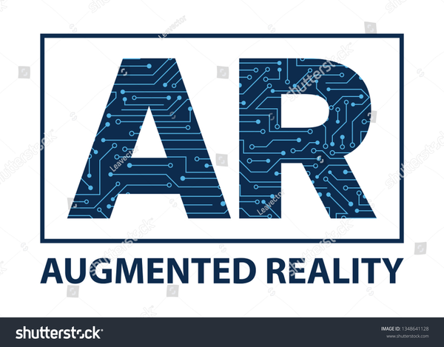
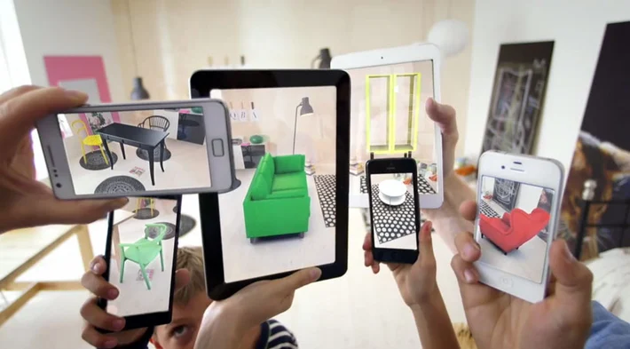
Augmented Reality(AR)
Augmented reality (AR) is an interactive technology that combines the real world with computer-generated content.
Key Features
A combination of digital and physical worlds.
Interactions made in real time.
Accurate 3D identification of virtual and real objects.
6

Slide 7
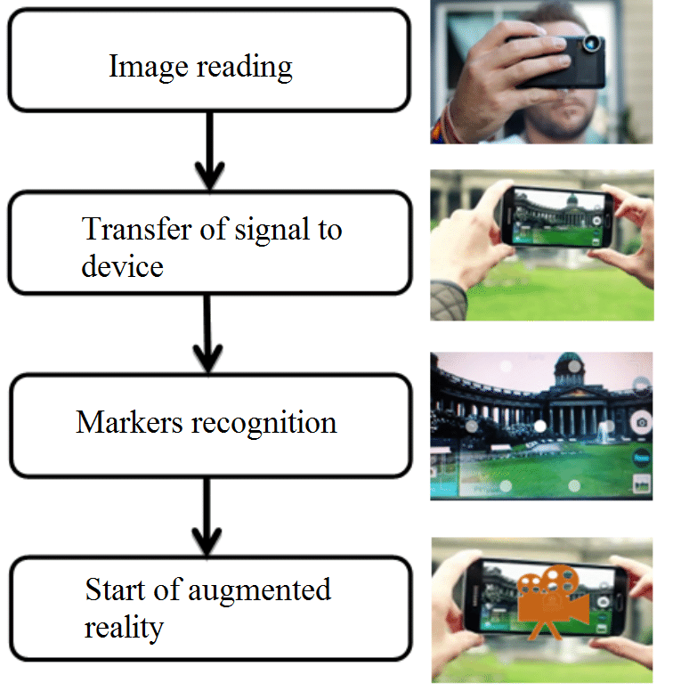
Augmented reality’S
Application
Image Reading: The device captures images or the environment using its camera.
Signal Transfer: The captured image is processed and signals are sent to the device.
Marker Recognition: The system identifies specific markers or objects in the scene.
Start of AR: Digital content is overlaid onto the real-world environment, creating an AR experience.
7

Slide 8

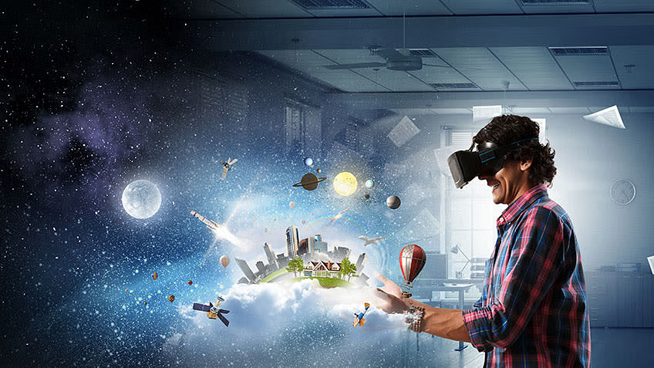
mixed reality(mr)
Mixed reality is a technology that combines VR and AR to create an immersive experience that blends the physical and digital worlds.
Key Features
Combines physical and virtual worlds seamlessly.
Merges AR and VR for deeper engagement.
Supports multi-user, shared environments.
8

Slide 9
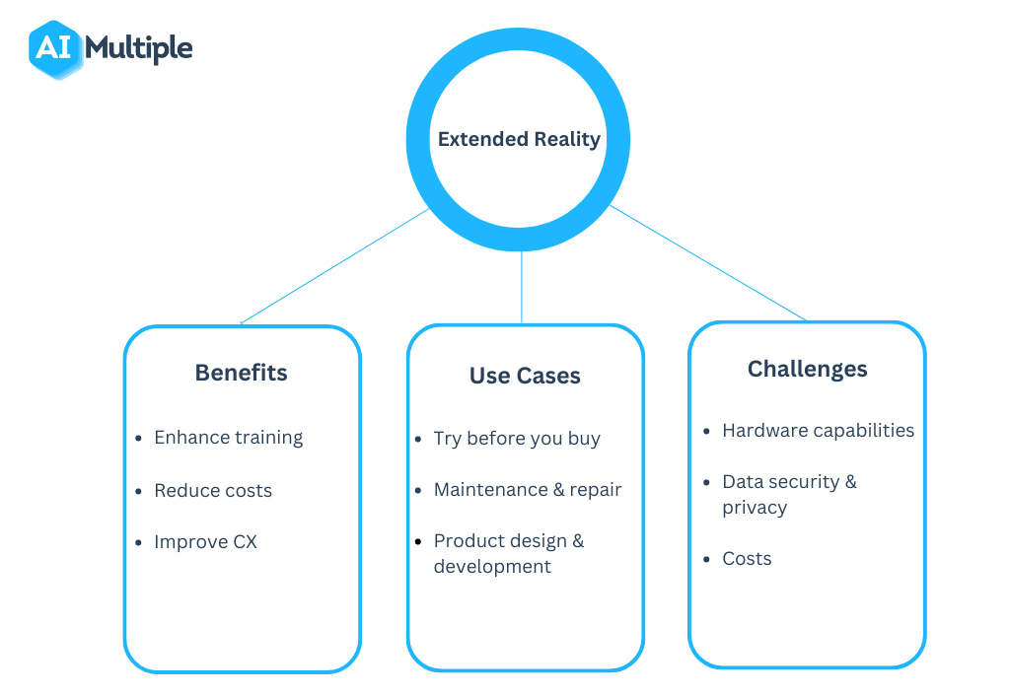
key aspects of Extended Reality
1. Benefits:
Enhances training with immersive simulations.
Improves customer experience (CX) with interactivity.
2. Use Cases:
Maintenance & repair assistance with AR overlays.
Product design & development in virtual environments.
3. Challenges:
Complex and costly hardware development.
Data security and privacy concerns.
9

Slide 10
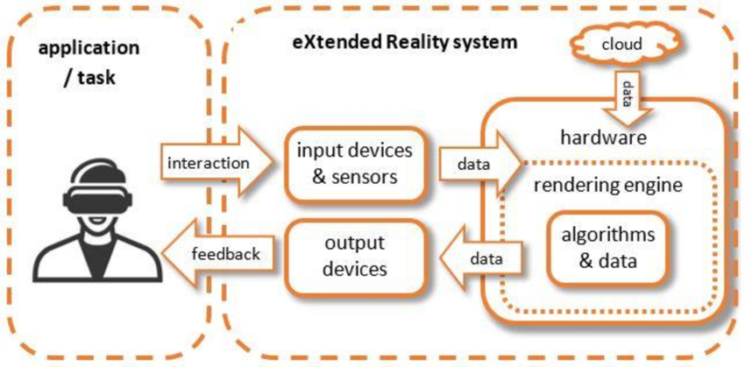
How Extended reality works
User Interaction
Input Devices & Sensors
Processing:
Hardware processes the input data.
Rendering Engine creates visuals.
Algorithms & Cloud
Output Devices
Feedback Loop
10

Slide 11
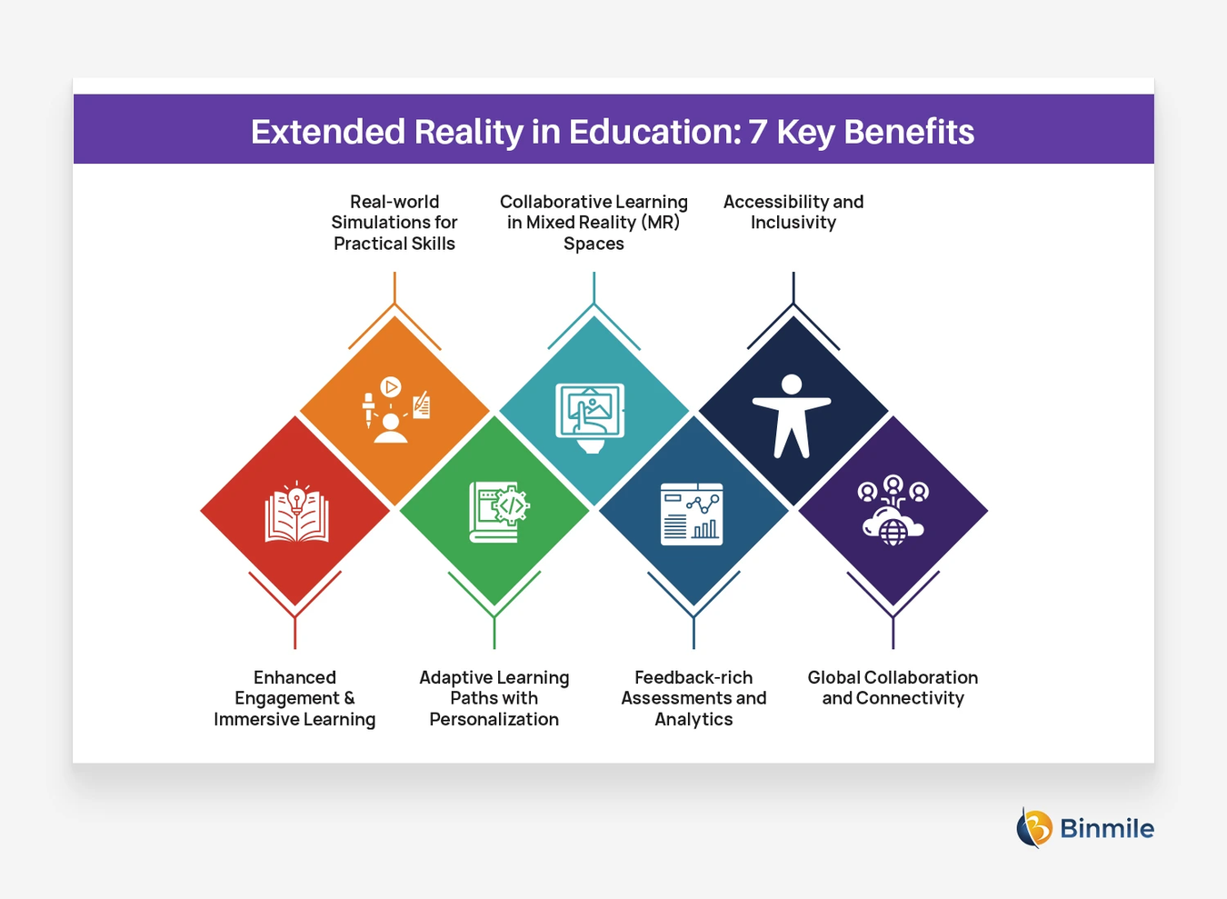
Extended reality in education
Students can practice real-world skills through simulations.
XR allows for personalized and adaptive learning experiences.
XR provides detailed feedback and analytics for assessments.
XR technology can make education more accessible and inclusive.
11

Slide 12
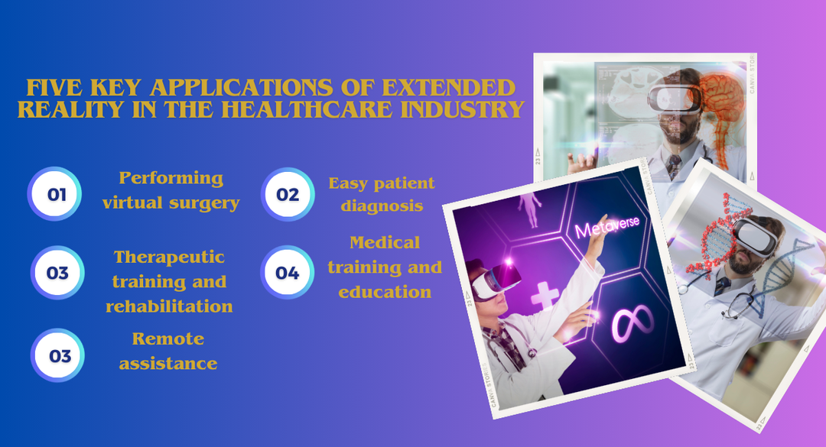
Extended reality in Health care
XR can be used for practicing and performing surgeries in a virtual environment, reducing risks.
XR helps in diagnosing patients more accurately and efficiently.
XR provides immersive environments therapeutic training.
XR is used for educating medical students.
XR enables remote medical assistance and healthcare providers globally.
12

Slide 13
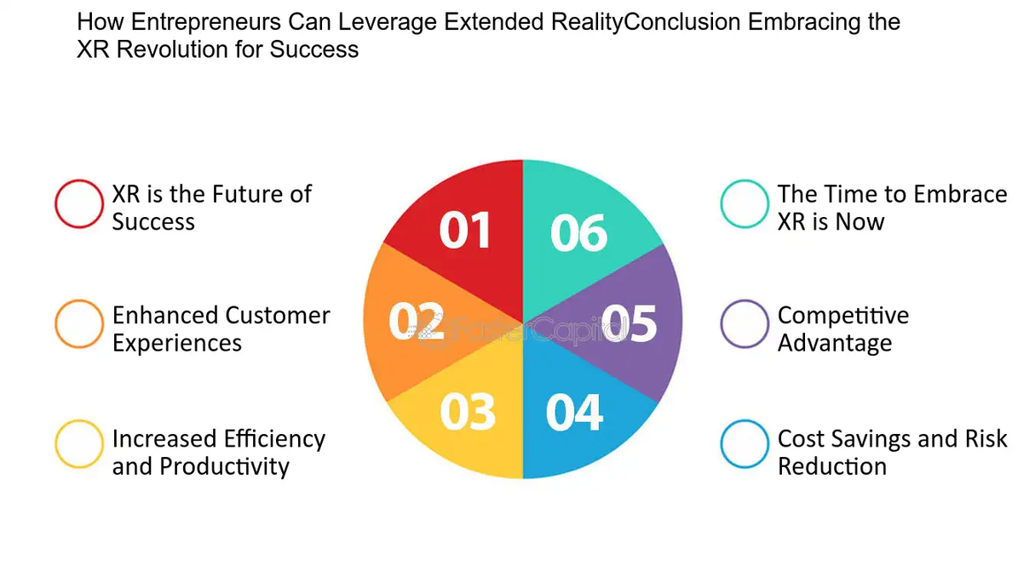
Conclusion: Embracing XR for Success
XR is the Future: A key driver of innovation and growth.
Enhanced Experiences: Creates immersive, customer-focused interactions.
Boosts Efficiency: Streamlines workflows and training processes.
Cuts Costs & Risks: Enables virtual testing and reduces overhead.
Competitive Edge: Early adoption sets businesses apart.
Act Now: Delaying adoption risks falling behind
13

Slide 14
thank you
Presented by Md. Sajid Islam
14

